Slide 1
Marketing Project
Reza Marzban
Code Available at: https://github.com/Reza-Marzban/Bank-Marketing-Data-Set-Classification

Slide 2

Dataset Introduction
Dataset name: Bank Marketing Data Set
Size: 41,188*21
41,188 rows (data points)
21 features (20 independent variable and 1 dependent variable.)
Time: May 2008 to November 2010
Programming language used for analysis: Python
Source: https://archive.ics.uci.edu/ml/datasets/Bank+Marketing

Slide 3
Target variable
The target variable is binary.
It shows if the client has subscribed a term deposit or not.
It is highly unbalanced.

Slide 4
Independent variables
20 total IVs.
10 numerical and 10 categorical variables.
The data contain some missing values in the data renamed as “unknown”.

Slide 5
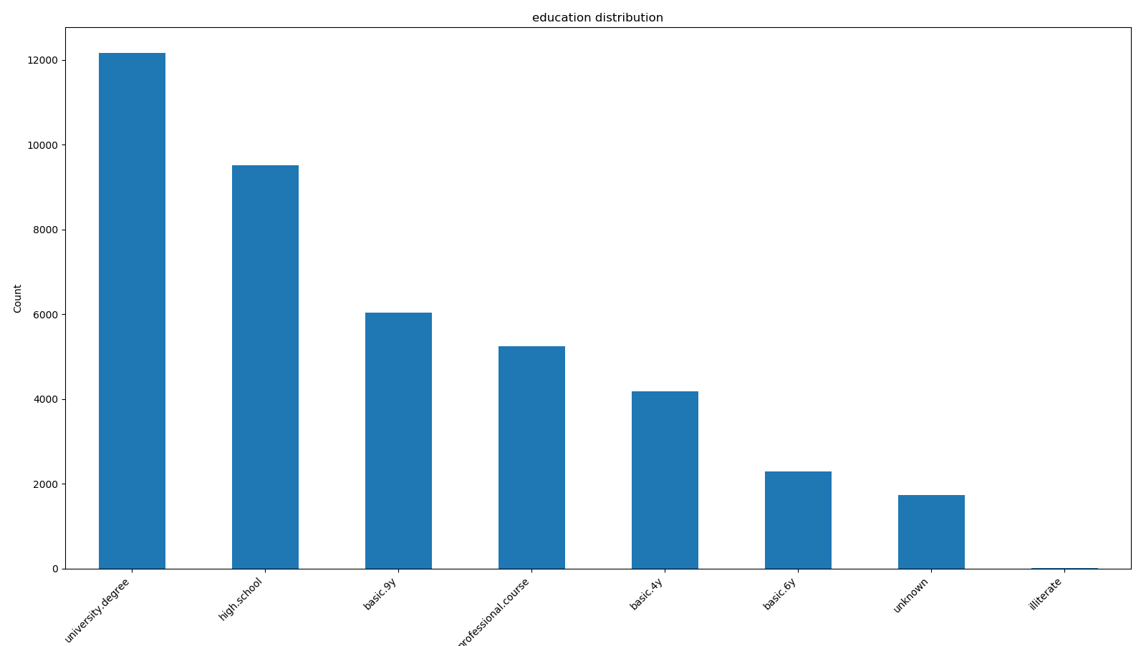
Independent variables - Education

Slide 6
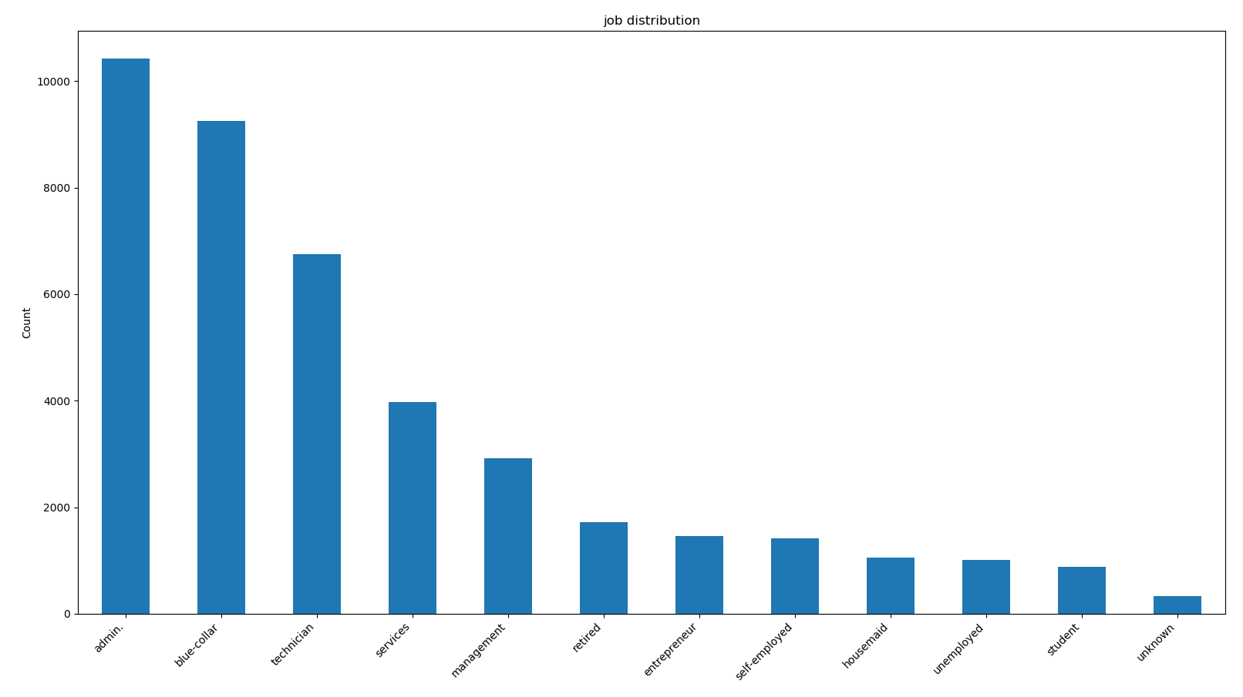
Independent variables - Job

Slide 7
Independent variables - Marital Statue

Slide 8
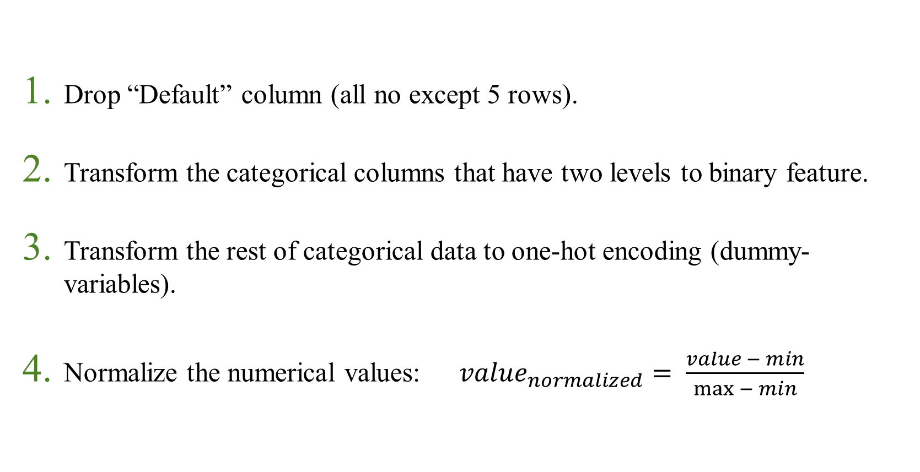
Pre-Processing phase
Drop “Default” column (all no except 5 rows).
Transform the categorical columns that have two levels to binary feature.
Transform the rest of categorical data to one-hot encoding (dummy-variables).
Normalize the numerical values: $value_{normalized}= \frac{value − min}{\max{− min}}$

Slide 9
Pre-Processing phase (Cont)
Balance the data (on target variable).
Shuffle the data.
Split to Train and Test sets with ratio of 80:20 respectively.
Number of features after cleaning: 52
Training set size: 6812
Test set size: 1704

Slide 10
Models
4 models were implemented, evaluated and compared on this data:
Naïve Bayes
Random Forest
Logistic Regression
Artificial Neural Networks

Slide 11
Model comparison
Models | Accuracy | Precision | Recall | F1 score | AUC
Baseline | 50.00% | 50.00% | 50.00% | 50.00% | 0.5000
Naïve Bayes | 72.36% | 84.01% | 54.02% | 65.75% | 0.7902
Random Forest | 87.97% | 84.96% | 91.76% | 88.23% | 0.9446
Logistic Regression | 86.15% | 85.64% | 86.02% | 85.92% | 0.9370
Artificial Neural Networks | 86.74% | 85.82% | 88.29% | 86.74% | 0.9365

Slide 12
Model comparison (cont.)

Slide 13
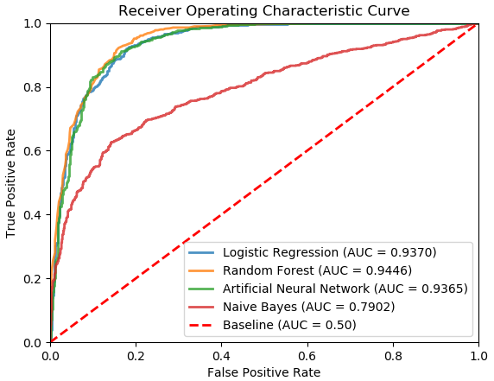
ROC curve

Slide 14
Confusion Matrix
Random Forest Confusion Matrix |  | Actual value
 |  | Positive | Negative | Total
Predicted value | Positive | 768 | 136 | 904
 | Negative | 69 | 731 | 800
 | Total | 837 | 867 | 1704

Slide 15
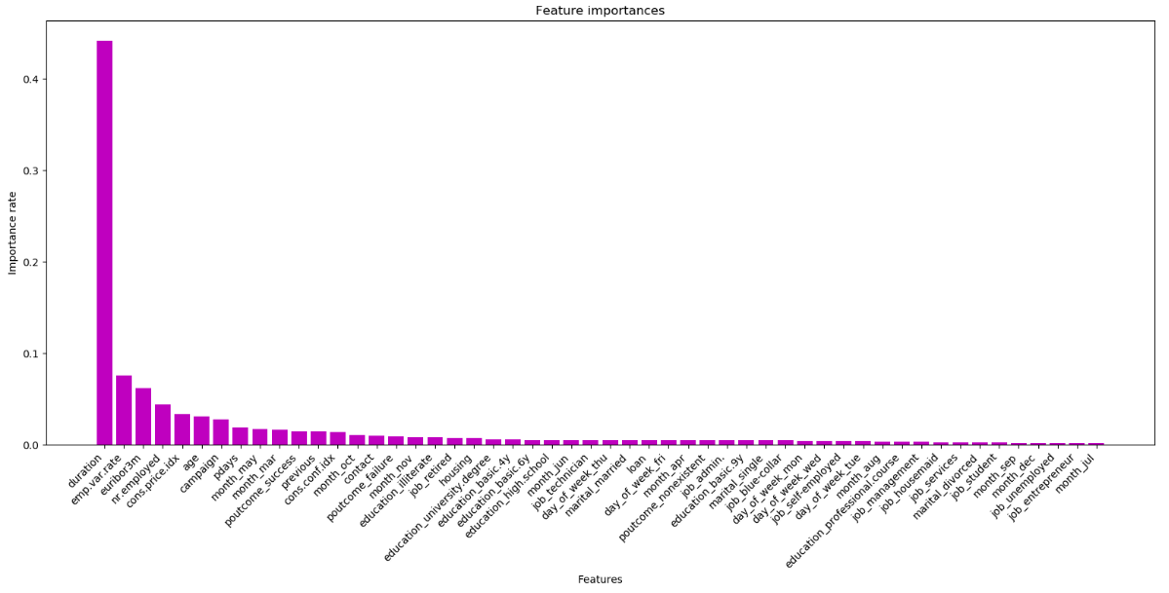
Feature importance voted by both Logistic Regression and Random Forest

Slide 16
Artificial Neural Network architecture
Layer | Output Shape | Number of parameters
Input | (?, 52) | 0
Dense (Relu) | (?, 32) | 1,696
Dense (Relu) | (?, 16) | 528
Dense (Relu) | (?, 8) | 136
Output (Sigmoid) | (?, 1) | 9
Total |  | 2,369
? Represents the number of data points in each batch (64 in this case)

Slide 17
Business impact
By creating similar models, bankers can make an educated guess instead of choosing users randomly to call.
It will increase the success rate.
It will make the bank to have more prospects with fewer calls and faster.

Slide 18
Summary
The data originally had 20 independent variables and 1 binary target variable.
After preprocessing, we had 52 features.
4 models were implemented, evaluated and compared.
Random forest was the best model achieving 87.97% in accuracy.

